Slide 1

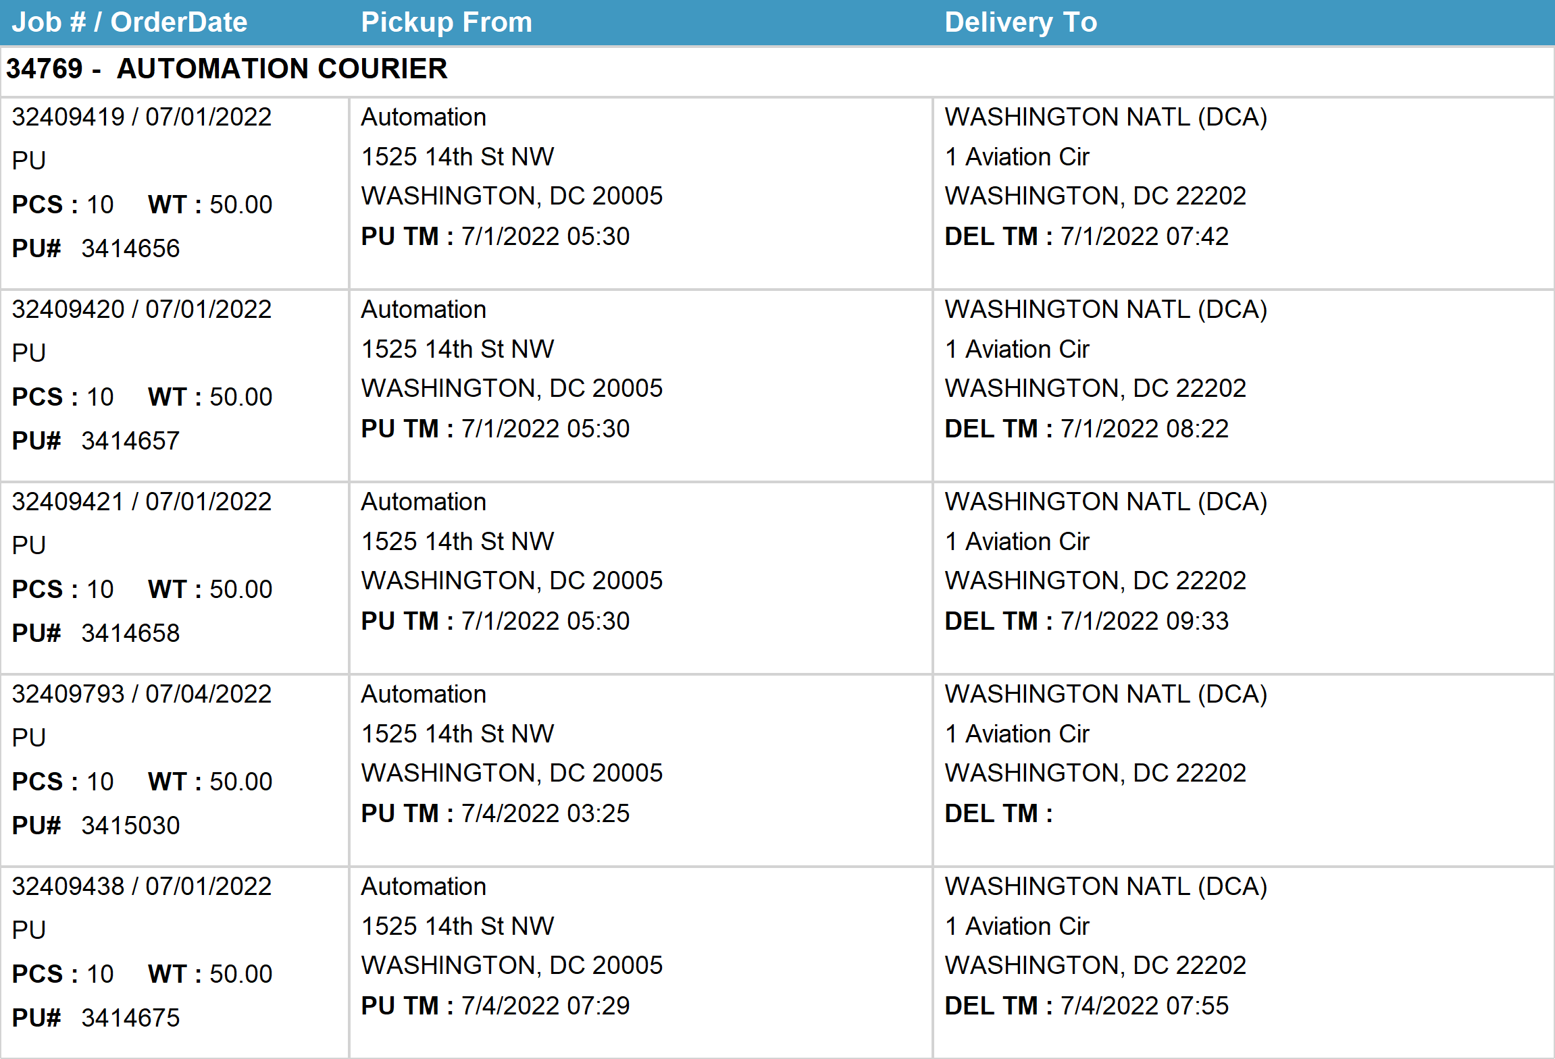
Agent Activity Report
*Data provided should be considered CONFIDENTIAL and PROPRIETARY*
©2011-2022 MNX Global Logistics. All rights reserved.
7/7/2022 11:13 PM
Print User : automation

Slide 2
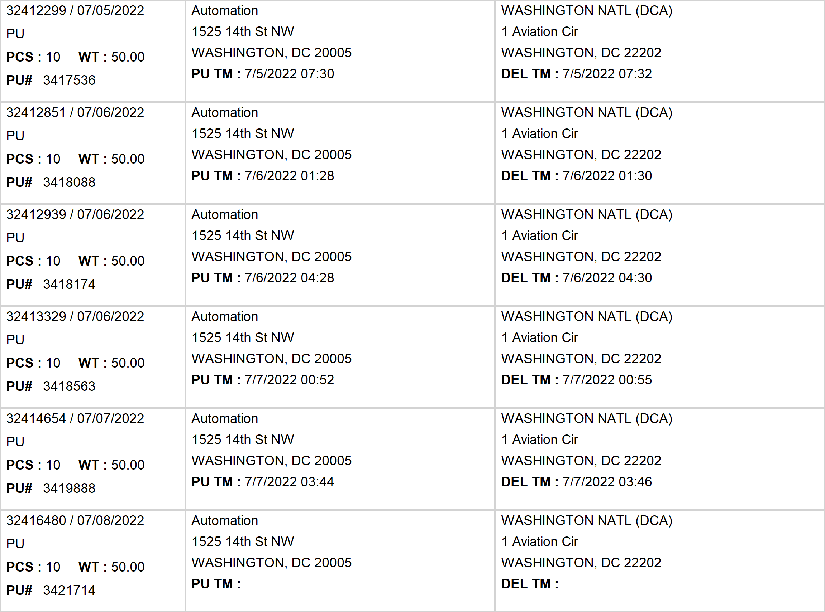
Agent Activity Report
*Data provided should be considered CONFIDENTIAL and PROPRIETARY*
©2011-2022 MNX Global Logistics. All rights reserved.
7/7/2022 11:13 PM
Print User : automation

Slide 3
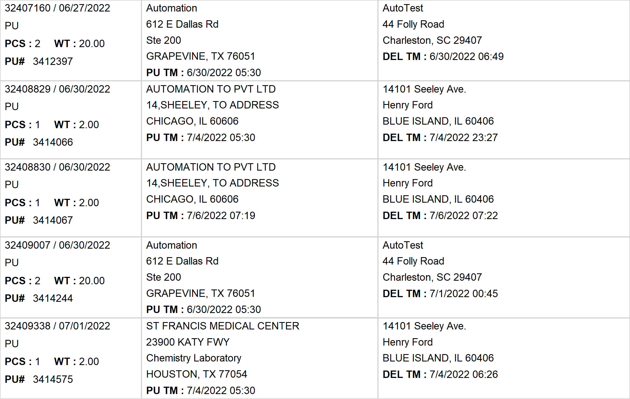
Agent Activity Report
*Data provided should be considered CONFIDENTIAL and PROPRIETARY*
©2011-2022 MNX Global Logistics. All rights reserved.
7/7/2022 11:13 PM
Print User : automation

Slide 4
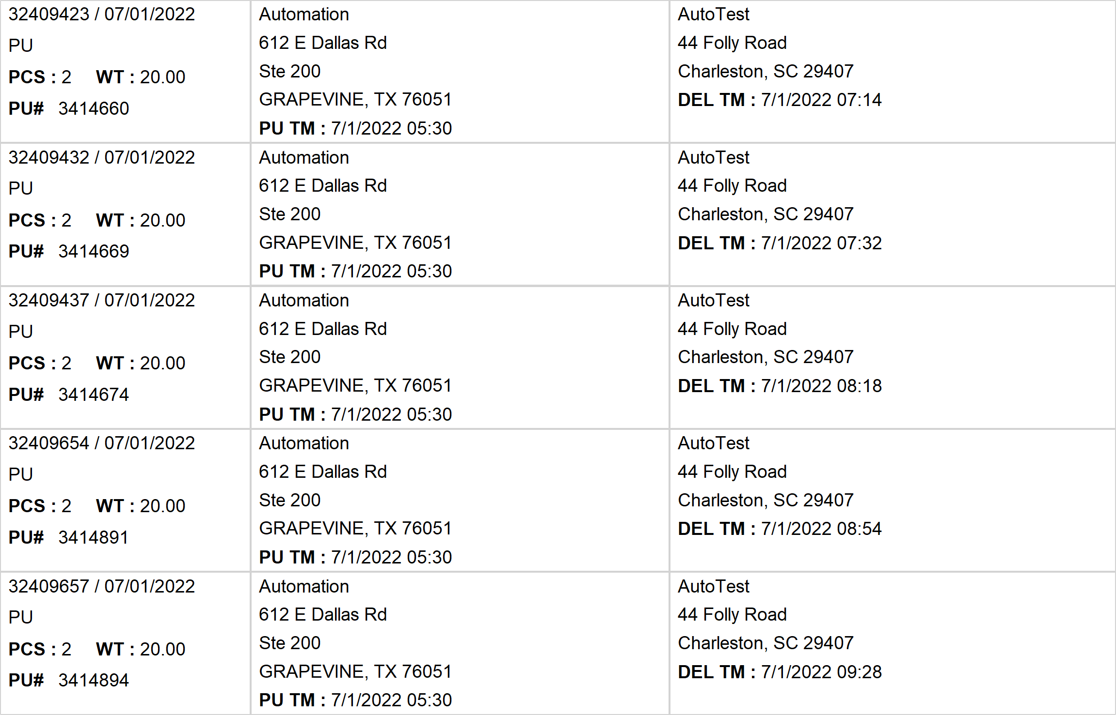
Agent Activity Report
*Data provided should be considered CONFIDENTIAL and PROPRIETARY*
©2011-2022 MNX Global Logistics. All rights reserved.
7/7/2022 11:13 PM
Print User : automation

Slide 5
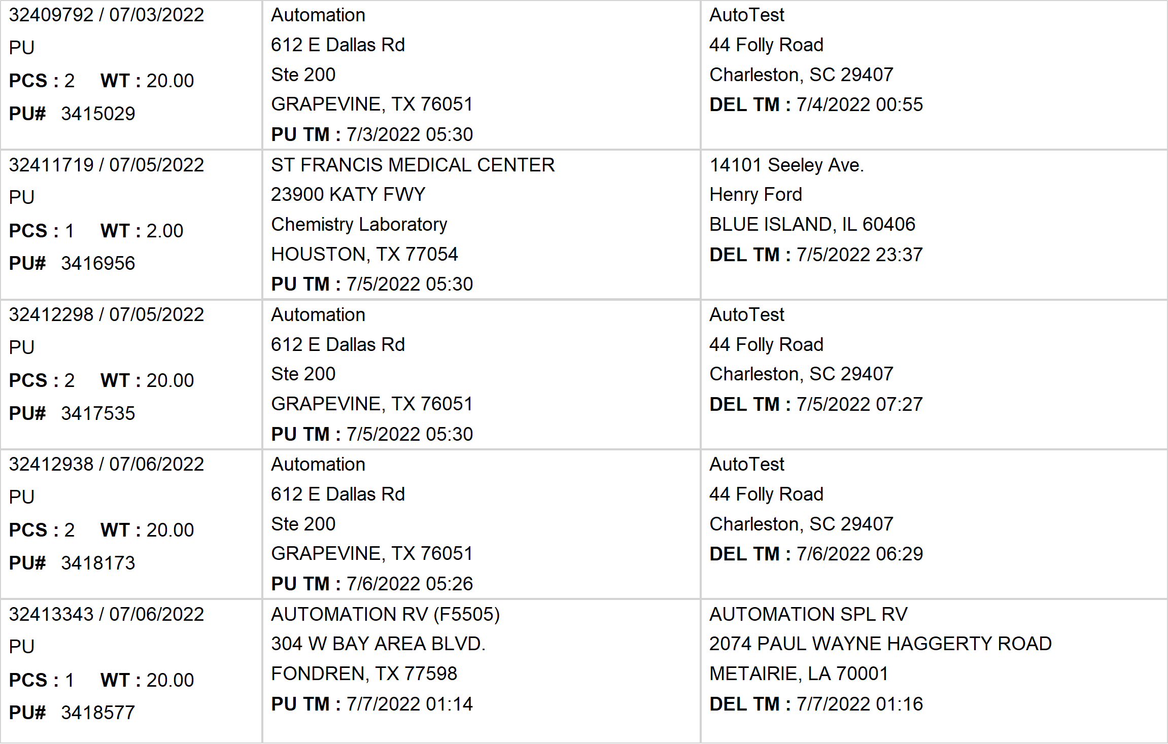
Agent Activity Report
*Data provided should be considered CONFIDENTIAL and PROPRIETARY*
©2011-2022 MNX Global Logistics. All rights reserved.
7/7/2022 11:13 PM
Print User : automation

Slide 6
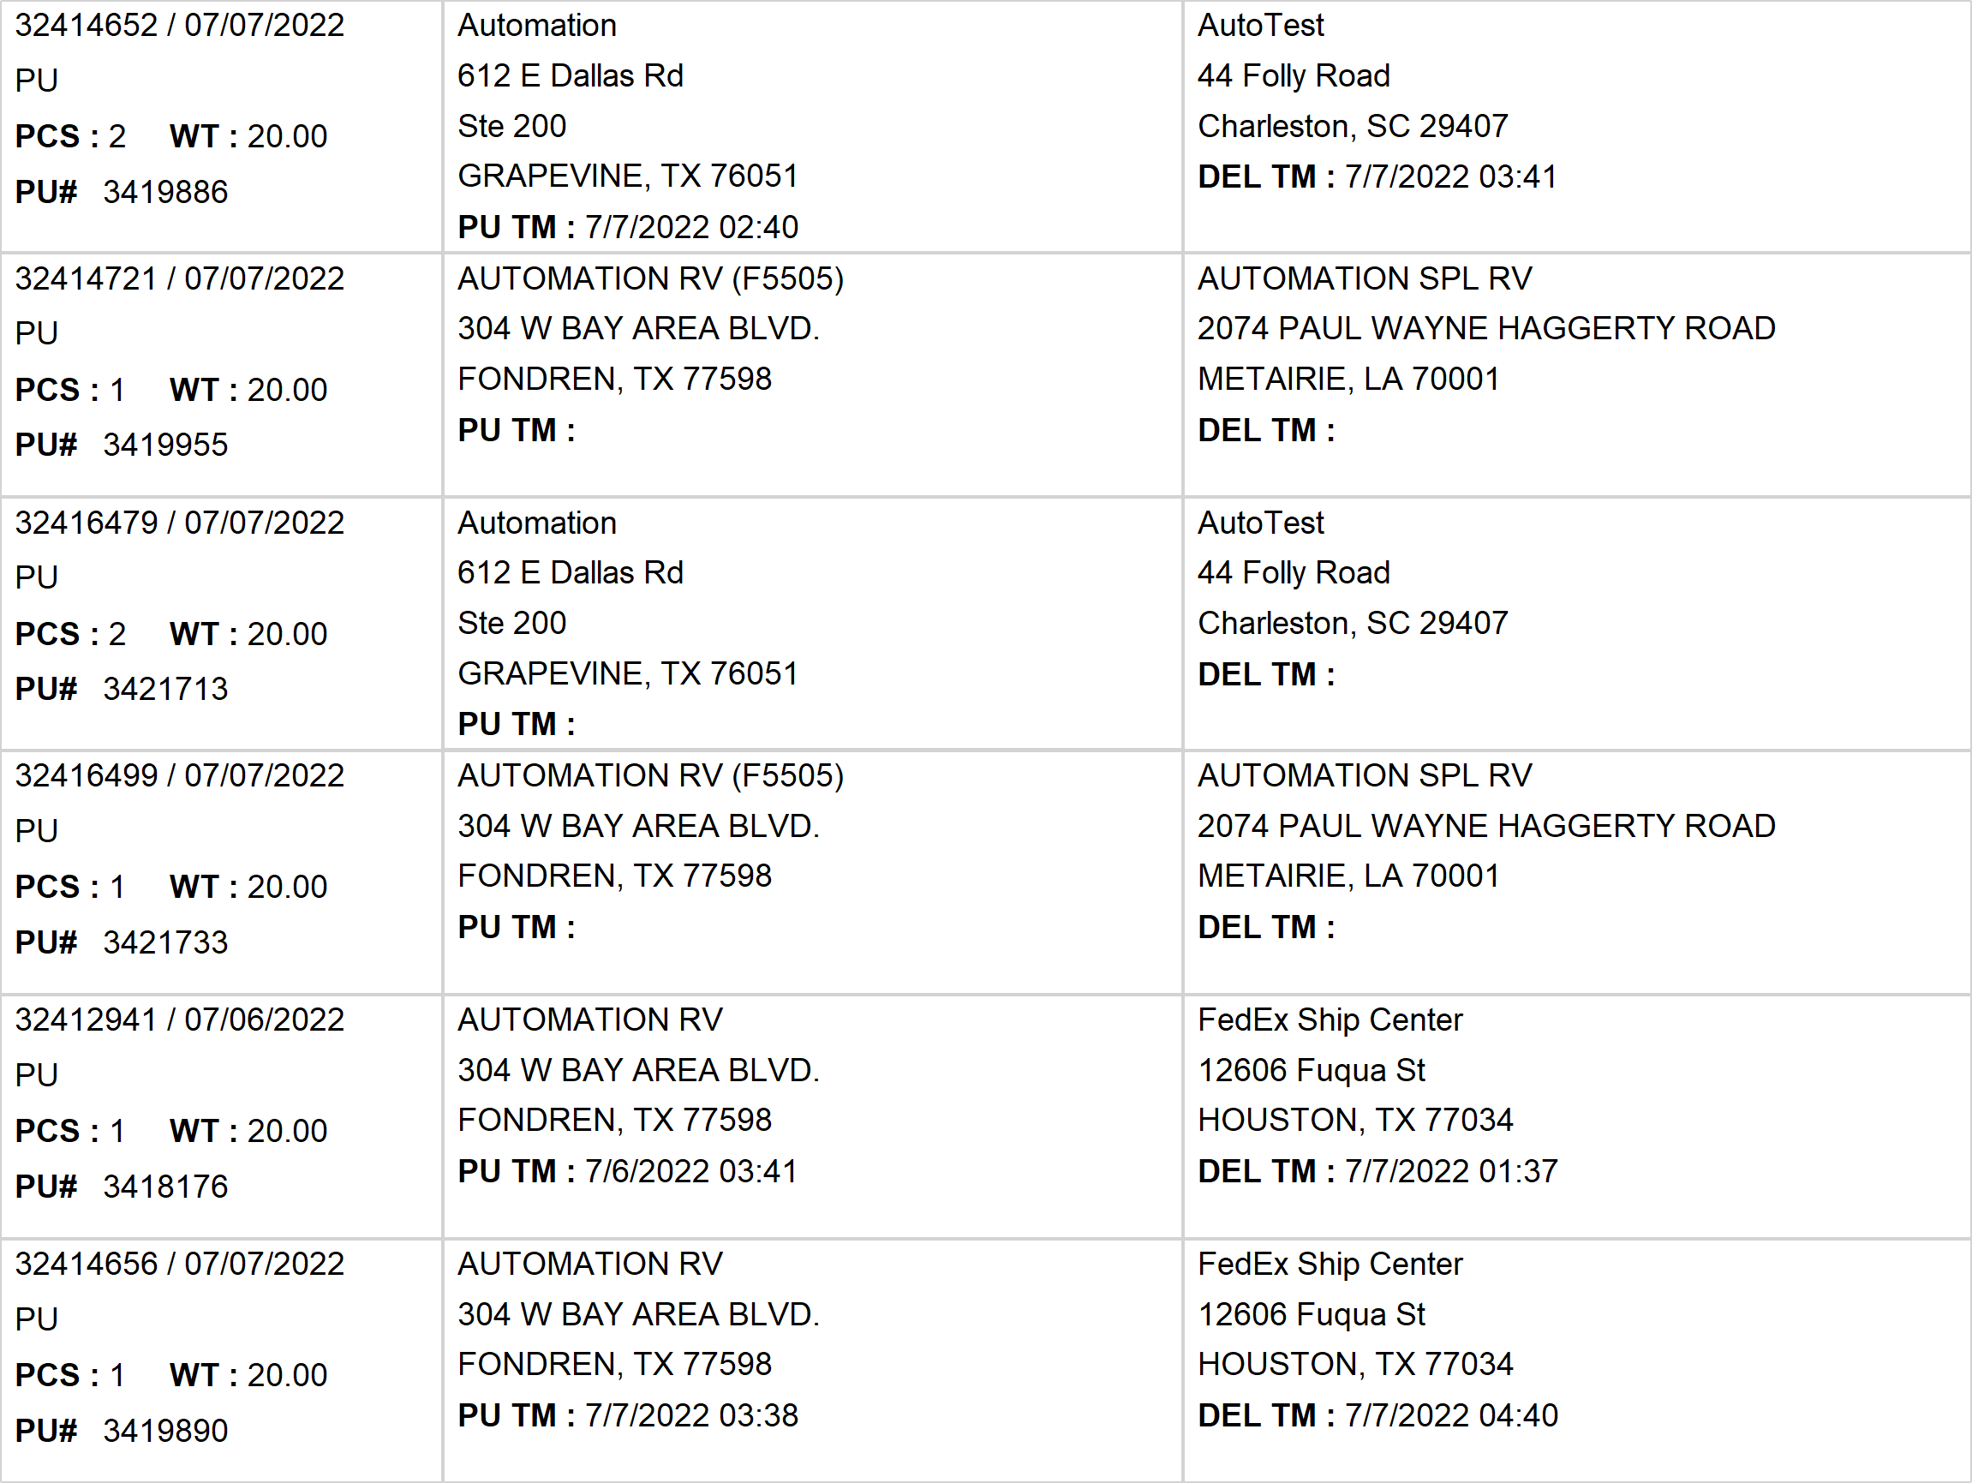
Agent Activity Report
*Data provided should be considered CONFIDENTIAL and PROPRIETARY*
©2011-2022 MNX Global Logistics. All rights reserved.
7/7/2022 11:13 PM
Print User : automation

Slide 7
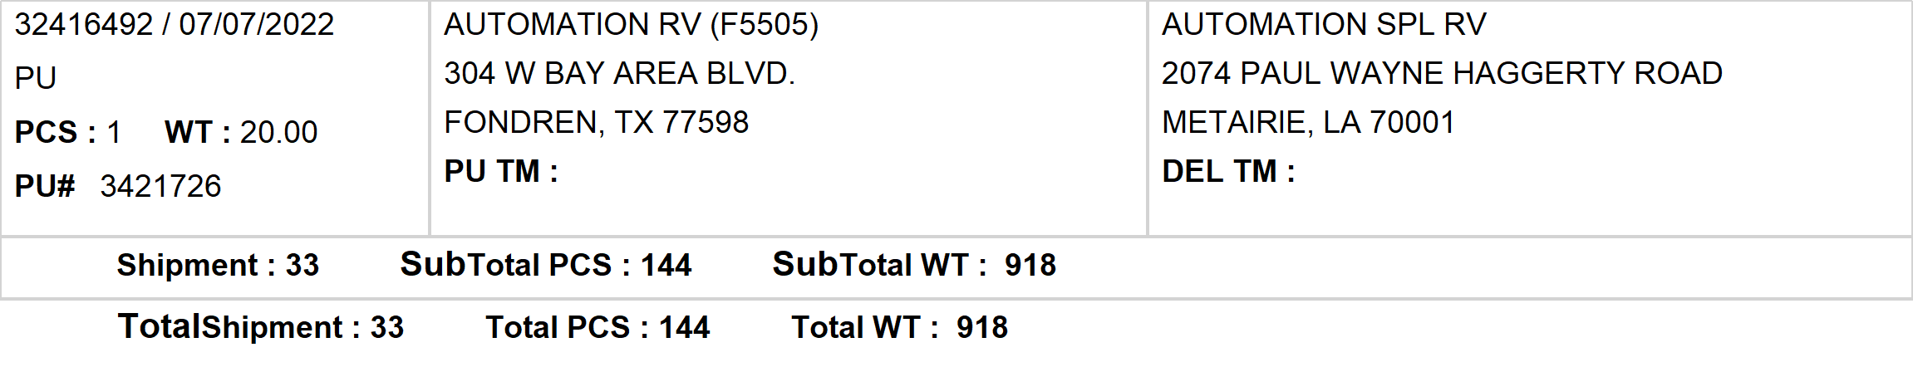
Agent Activity Report
*Data provided should be considered CONFIDENTIAL and PROPRIETARY*
©2011-2022 MNX Global Logistics. All rights reserved.
7/7/2022 11:13 PM
Print User : automation

